Slide 1




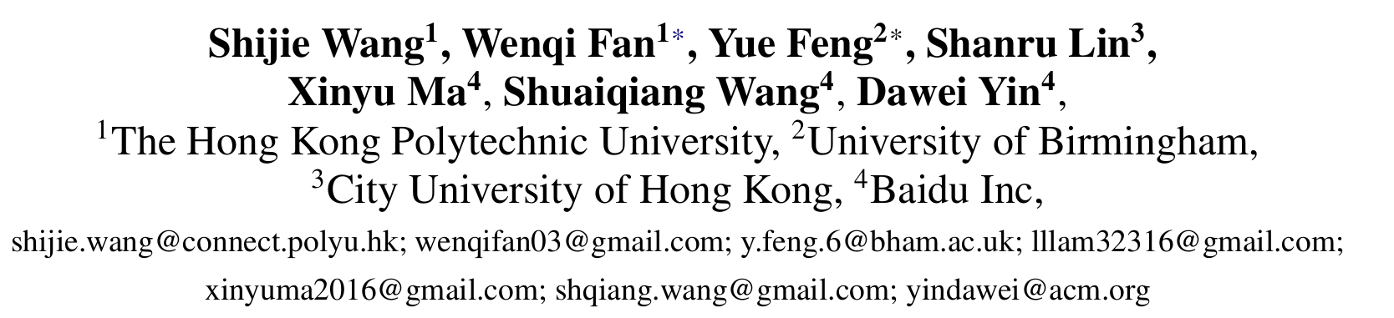





ATAI
Advanced Techniqueof Artificial Intelligence
ATAI
ChongqingUniversity _{AdvancedTechniqueof}
of Technology Artificial Intelligence
Chongqing University of
Technology
Chongqing University ^{ATAI}
_{of Technology} Advanced Techniqueof
Artificial Intelligence
Chongqing University of Technology
Chongqing University of Technology
  Knowledge Graph Retrieval-Augmented Generation for
  LLM-based Recommendation
Code: None
2025.11.23•ChongQing
—— ACL 2025
Reported by Shunan Yin
1
Notes:
知识图谱检索增强生成用于基于大模型的推荐

Slide 2

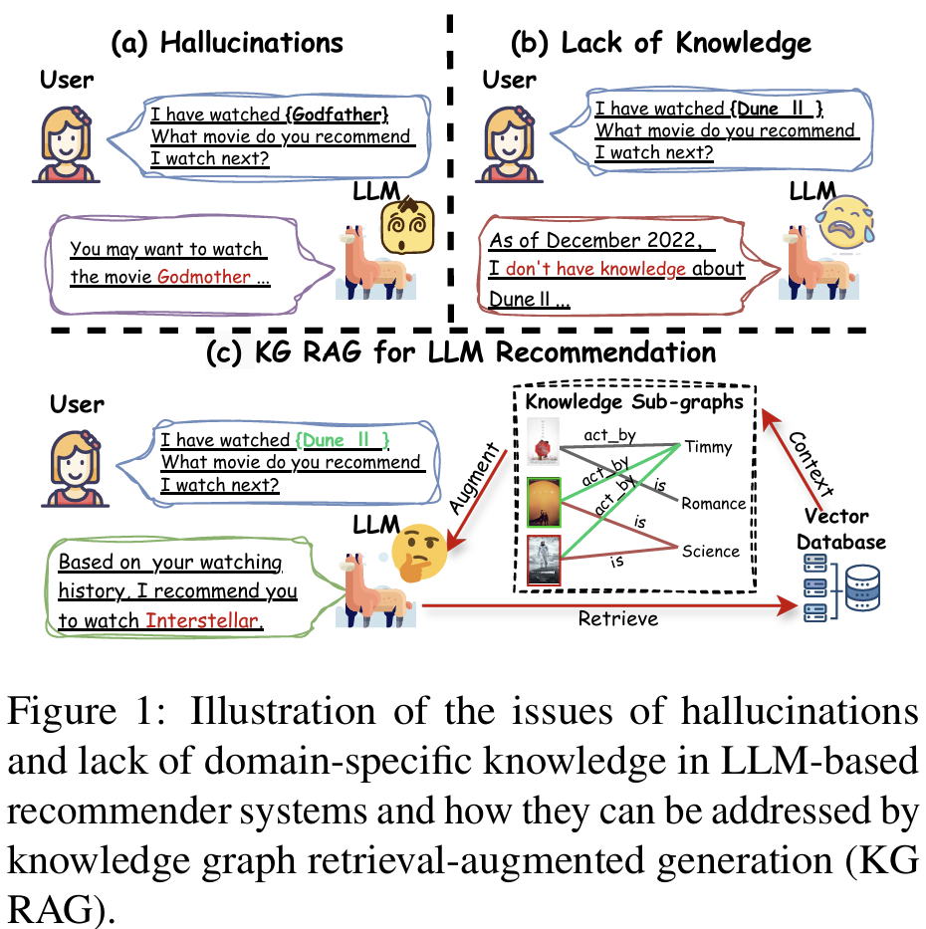
ATAI
AdvancedTechniqueof
Artificial Intelligence
ATAI
ChongqingUniversity _{AdvancedTechniqueof}
of Technology Artificial Intelligence
ChongqingUniversity of Technology
Motivation
1)LLM-based recommender systems may generate recommendations that are fictional due to the inherent limitations of LLMs.
2)LLMs usually lack up-to-date knowledge, which can prevent them from recommending the latest films or products.
3)LLMs often lack domain-specific knowledge, as recommendation-oriented corpora are very limited during the training phase of LLMs.

Slide 3

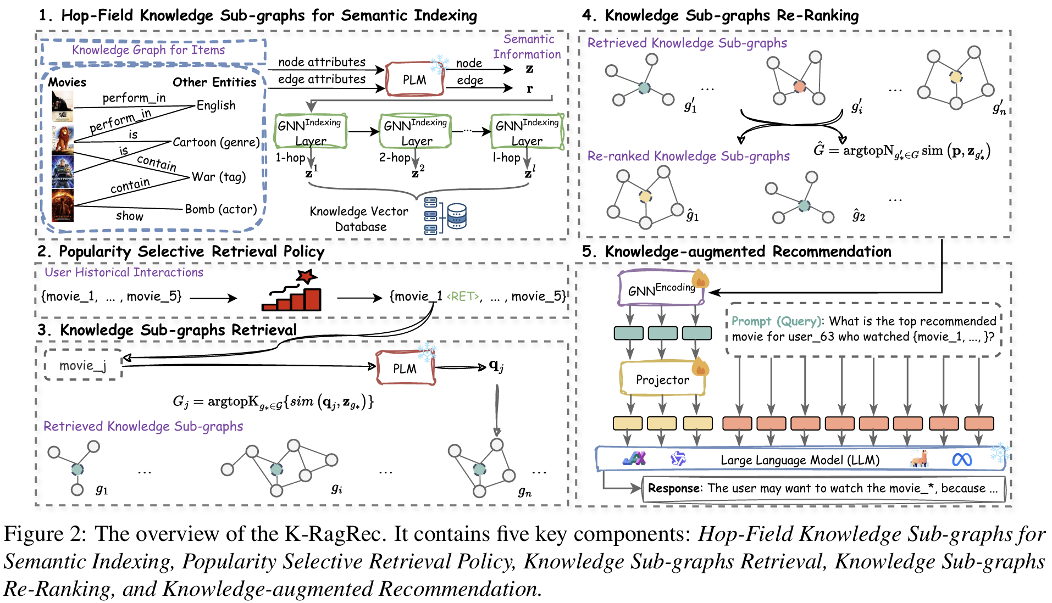
ChongqingUniversity of Technology
ATAI
AdvancedTechniqueof
Artificial Intelligence
ATAI
ChongqingUniversity _{AdvancedTechniqueof}
of Technology Artificial Intelligence
Overview

Slide 4

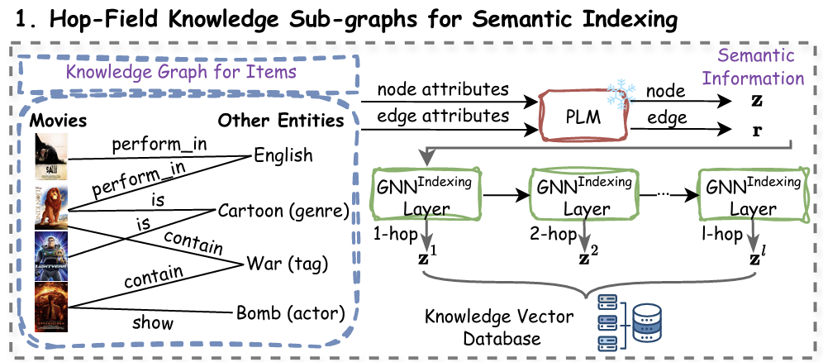

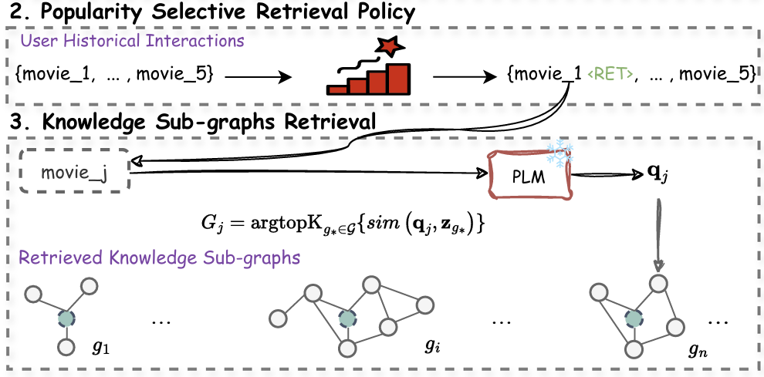
ChongqingUniversity of Technology
Method
ATAI
AdvancedTechniqueof
Artificial Intelligence
ATAI
ChongqingUniversity _{AdvancedTechniqueof}
of Technology Artificial Intelligence

Slide 5
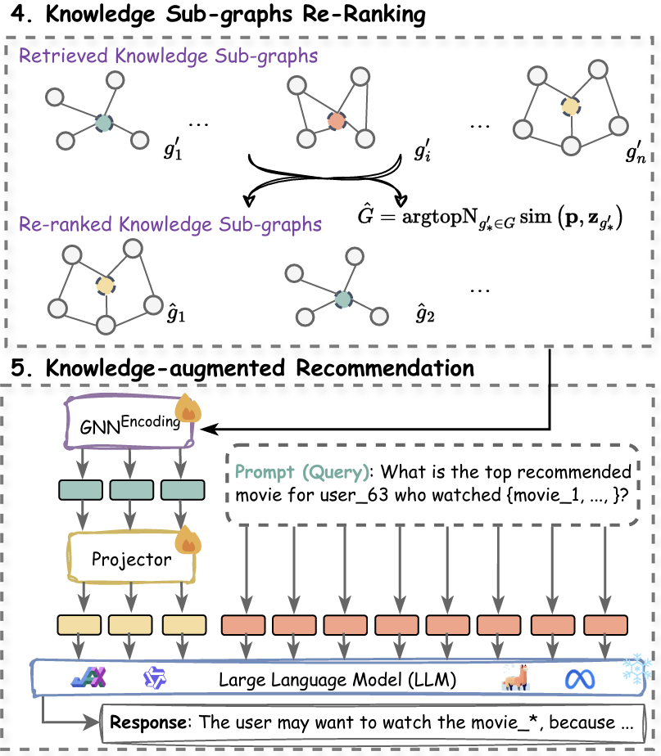

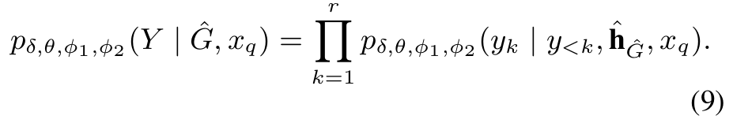
ChongqingUniversity of Technology
Method
ATAI
AdvancedTechniqueof
Artificial Intelligence
ATAI
ChongqingUniversity _{AdvancedTechniqueof}
of Technology Artificial Intelligence

Slide 6

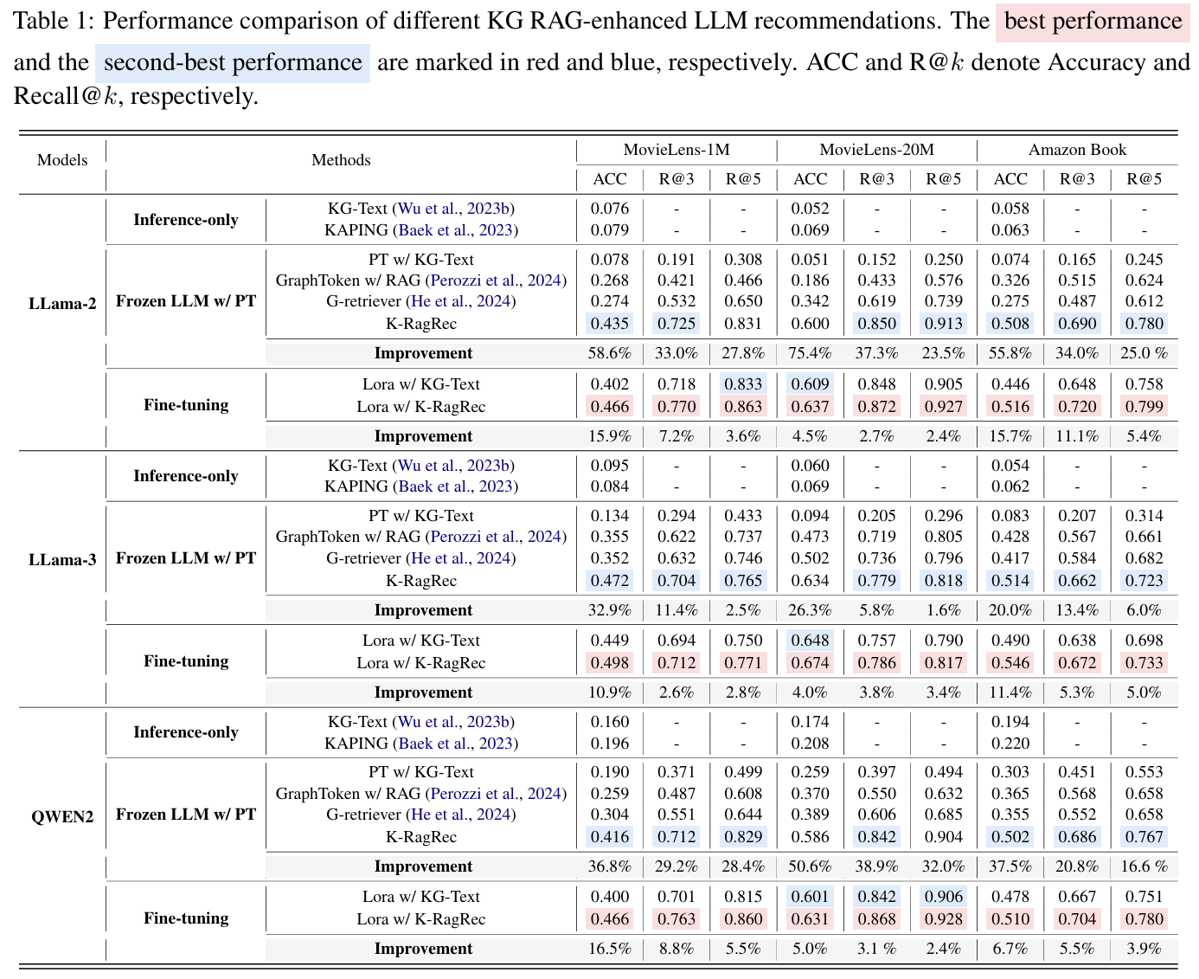
Experiments
ATAI
AdvancedTechniqueof
Artificial Intelligence
ATAI
ChongqingUniversity _{AdvancedTechniqueof}
of Technology Artificial Intelligence
ChongqingUniversity of Technology

Slide 7
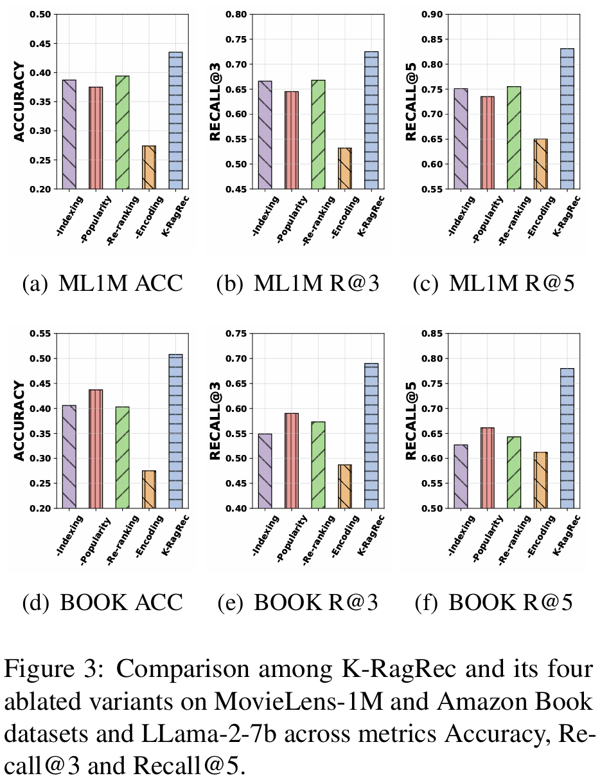
Experiments
ATAI
AdvancedTechniqueof
Artificial Intelligence
ATAI
ChongqingUniversity _{AdvancedTechniqueof}
of Technology Artificial Intelligence
ChongqingUniversity of Technology

Slide 8
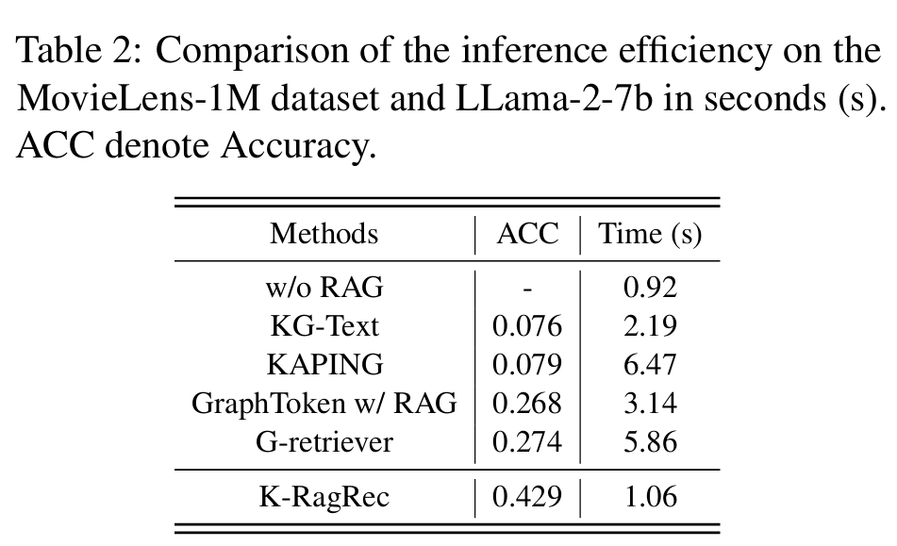
ATAI
AdvancedTechniqueof
Artificial Intelligence
ATAI
ChongqingUniversity _{AdvancedTechniqueof}
of Technology Artificial Intelligence
ChongqingUniversity of Technology
Experiments

Slide 9
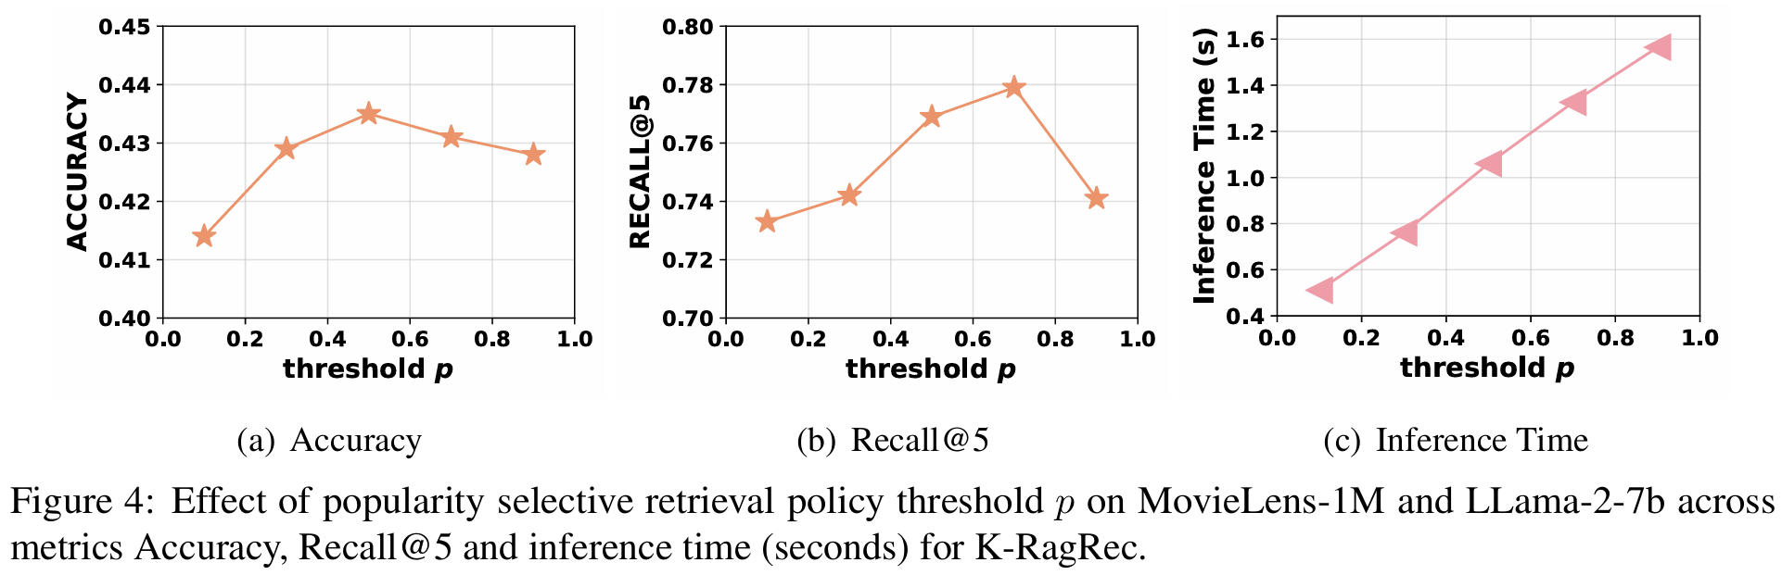
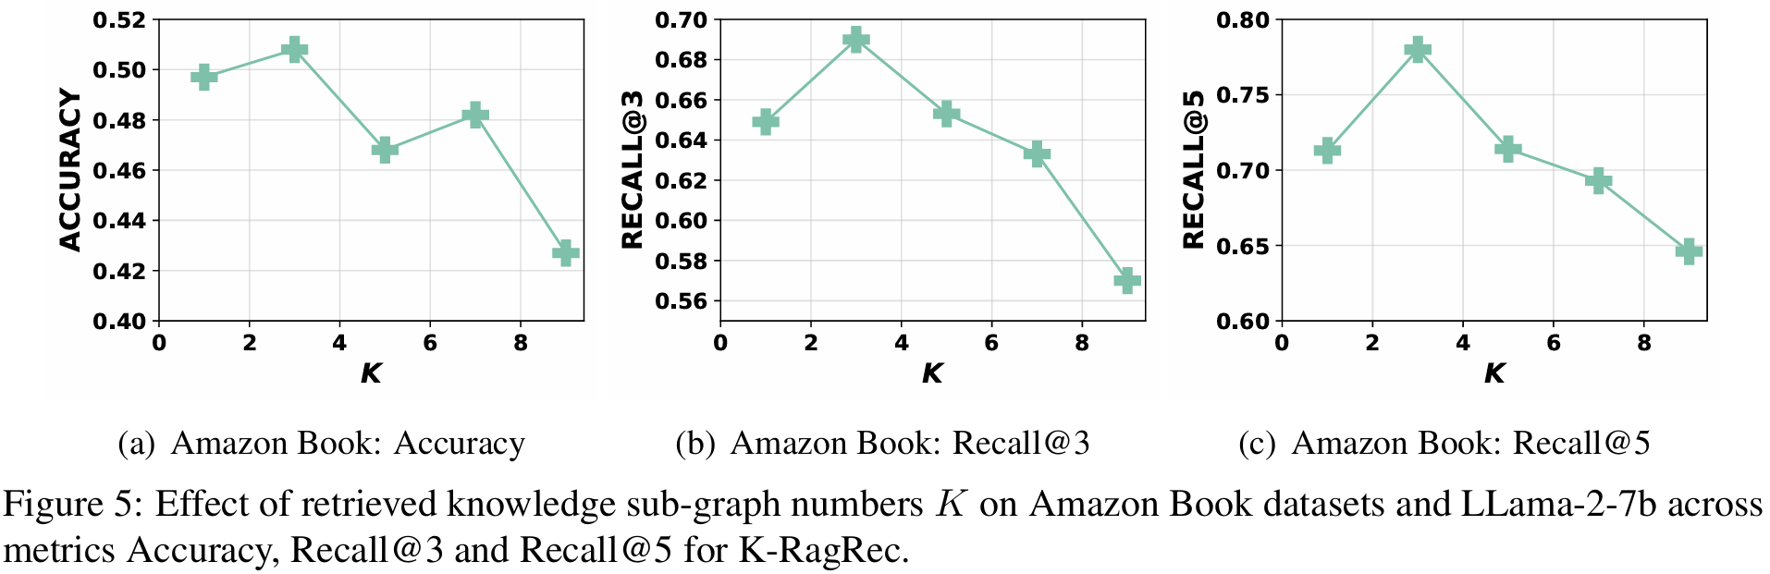
Experiments
ATAI
AdvancedTechniqueof
Artificial Intelligence
ATAI
ChongqingUniversity _{AdvancedTechniqueof}
of Technology Artificial Intelligence
ChongqingUniversity of Technology

Slide 10
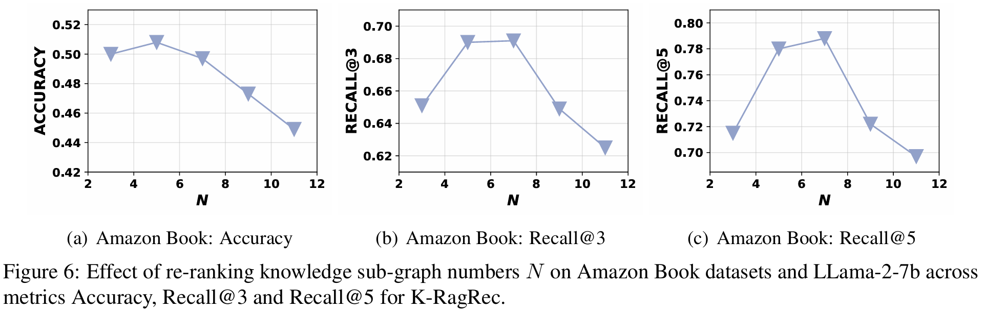
Experiments
ATAI
AdvancedTechniqueof
Artificial Intelligence
ATAI
ChongqingUniversity _{AdvancedTechniqueof}
of Technology Artificial Intelligence
ChongqingUniversity of Technology

Slide 11


ChongqingUniversity of Technology
ATAI
AdvancedTechniqueof
Artificial Intelligence
ATAI
ChongqingUniversity _{AdvancedTechniqueof}
of Technology Artificial Intelligence
Thanks!

